Slide 1


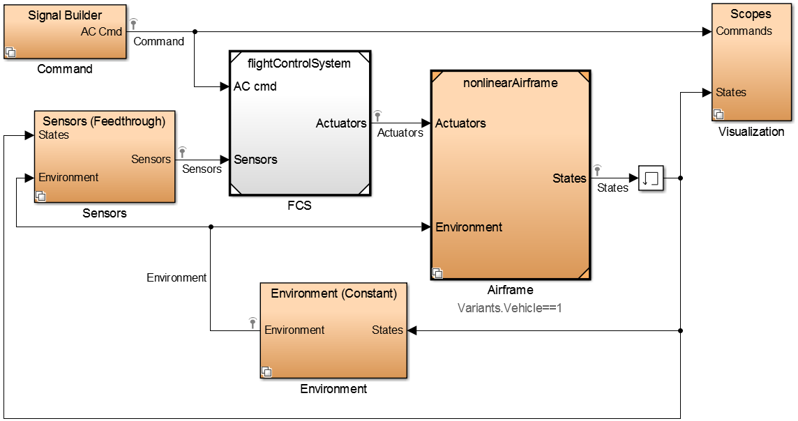
FlyNet: Autonomous Quadcopter Search and Rescue
Simulation
Input → Flight controller → Airframe

Slide 2
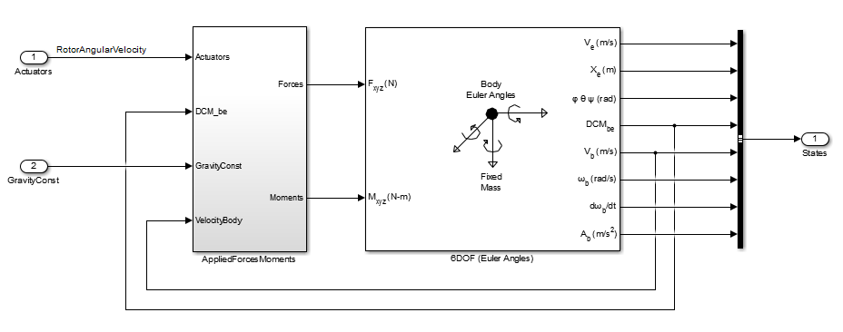
FlyNet: Autonomous Quadcopter Search and Rescue
Airframe Modelling
Use Simulink 6DOF block to simulate equations of motion in the quadcopter body coordinate frame.

Slide 3
FlyNet: Autonomous Quadcopter Search and Rescue
Applied Forces
Gravity
Motor thrust
Aerodynamic forces
Drag (lumped parameter model)
Ground effects
Applied Moments
Motor thrust
Other considerations
Rotational dynamics
Motor dynamics

Slide 4
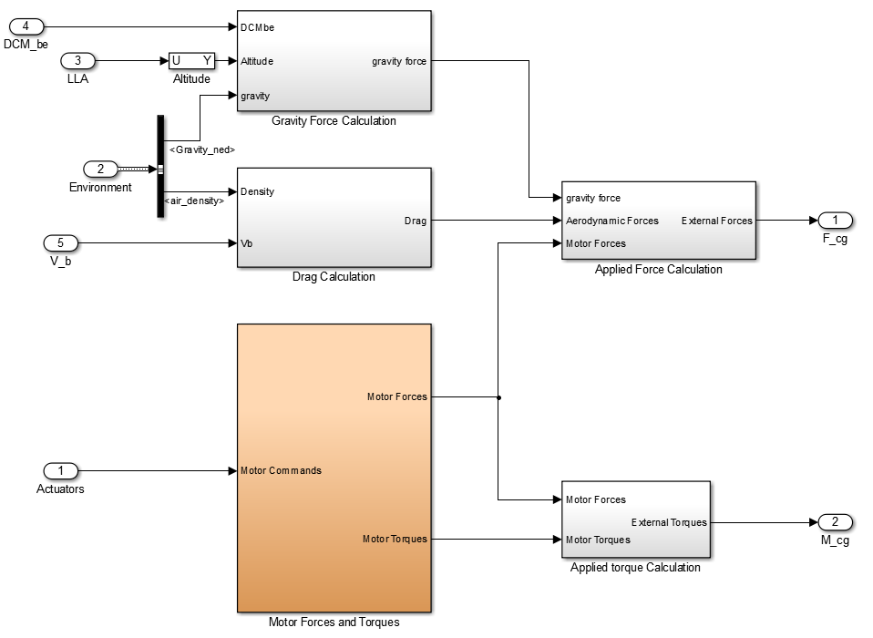
FlyNet: Autonomous Quadcopter Search and Rescue
Applied forces and moments

Slide 5
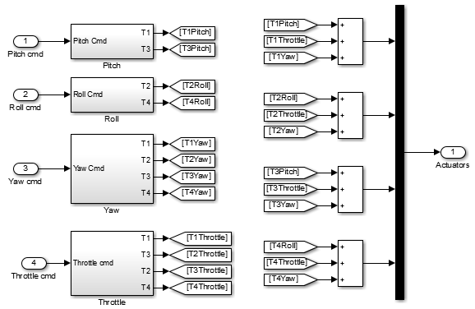
FlyNet: Autonomous Quadcopter Search and Rescue
Flight control (actuator outputs for given roll, pitch, yaw, and throttle commands

Slide 6
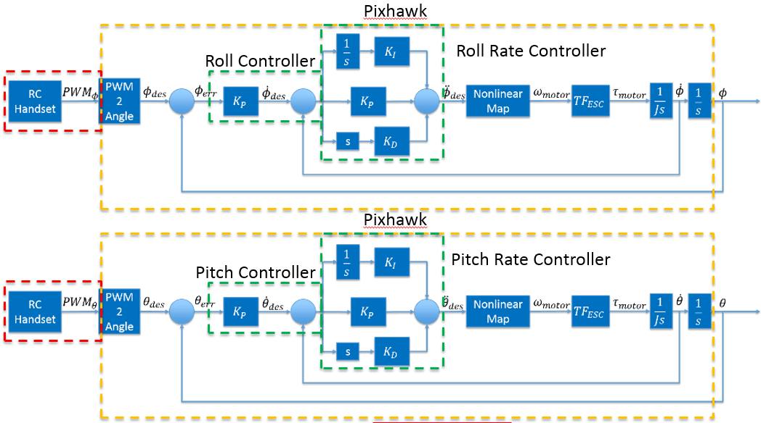
FlyNet: Autonomous Quadcopter Search and Rescue
Stabilize Mode

Slide 7
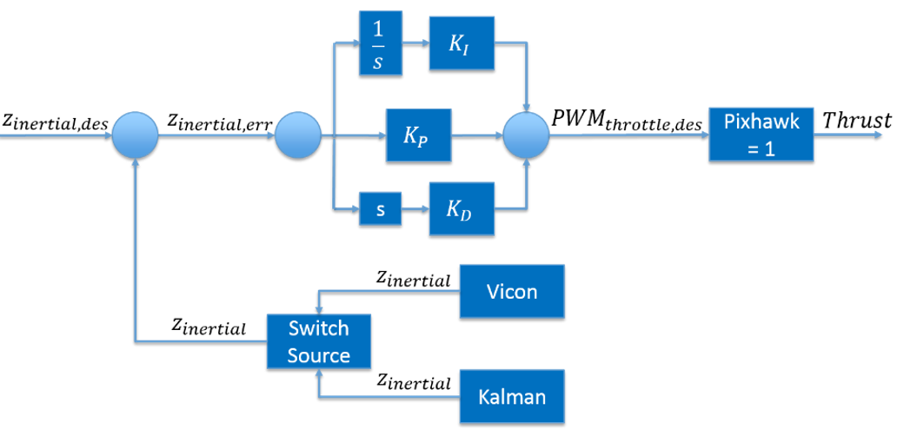
FlyNet: Autonomous Quadcopter Search and Rescue
Altitude Control

Slide 8
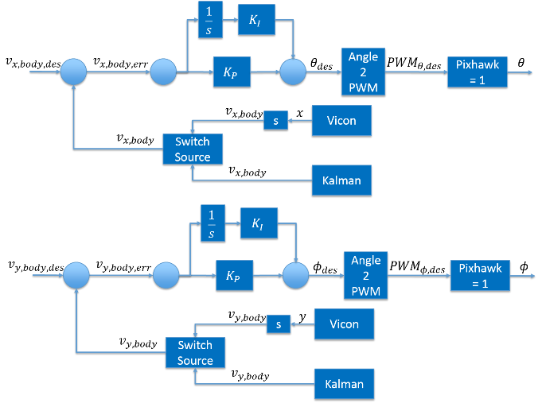
FlyNet: Autonomous Quadcopter Search and Rescue
Velocity Control

Slide 9
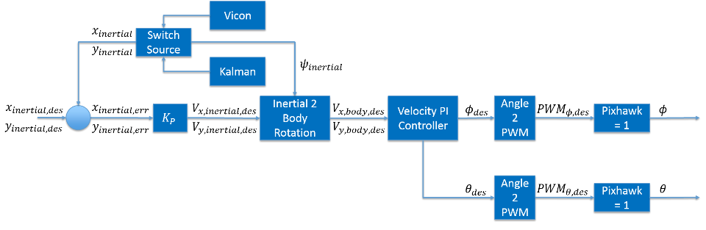
FlyNet: Autonomous Quadcopter Search and Rescue
Position Control

Slide 10
FlyNet: Autonomous Quadcopter Search and Rescue
Next steps
Test hardware to determine accurate coefficients
Motor thrust per (rotational velocity)²
Motor rotational velocity per PWM input
Quadcopter frame arm length
Quadcopter moment of inertia
Simulate Pixhawk controller in Simulilnk
Validate simulation against experimental flight data

